Slide 1
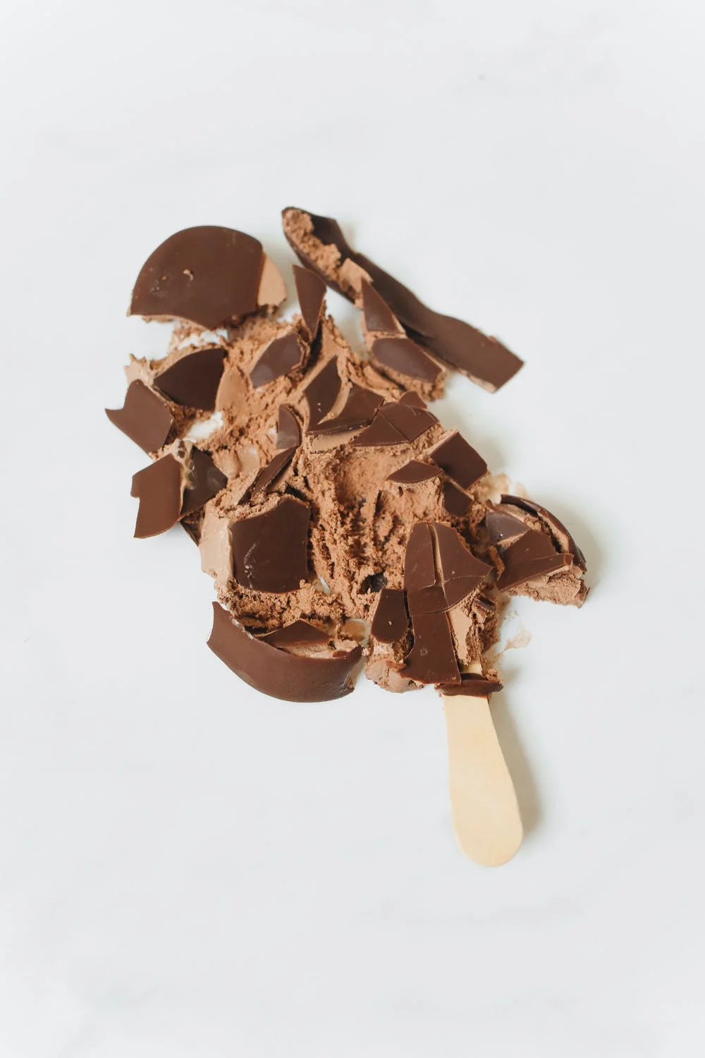

COCO-ICE & OMNILOM
ADVERTISING PITCH 1.0
MAY 2024

Slide 2

AGENDA
01
BRIEF
02
STRATEGY
03
TARGET AUDIENCE
04
COMPETITORS
06
CAMPAIGN PLAN
07
BUDGET

Slide 3
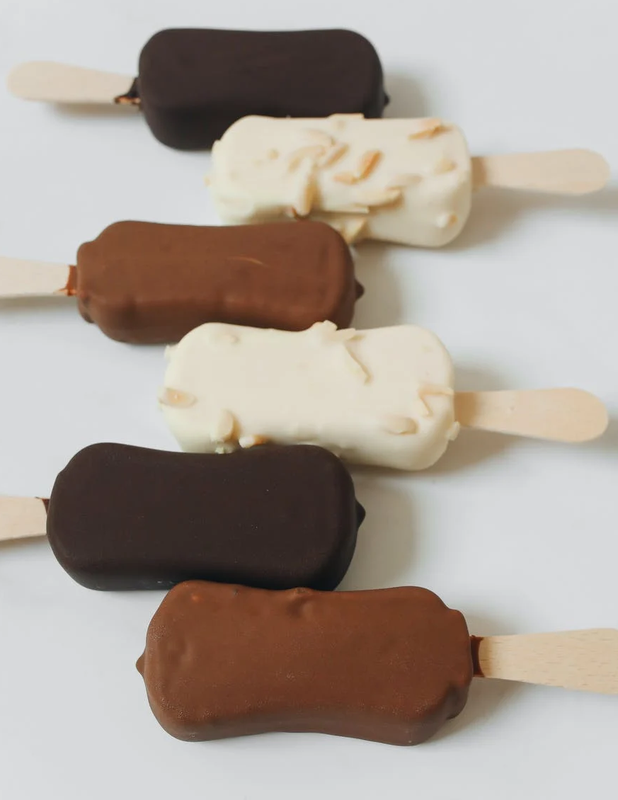

CREATIVE BRIEF
IMAGE CAPTION
It's no secret — your potential new client, the latest ice cream makers on the vegan wave — are on the hunt for a new approach. How do you differentiate in an already saturated market and convince more people to get on board the vegan dessert train?
IMAGE CAPTION

Slide 4
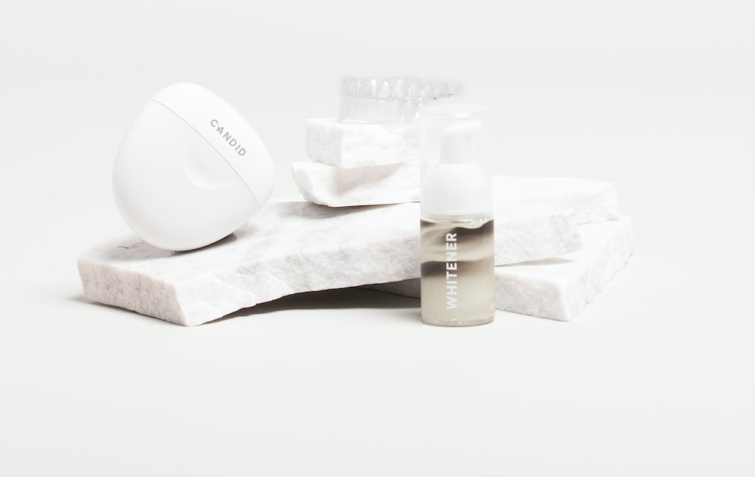
HELLO, WE ARE OMNILON. "ICE" TO MEET YOU.
Start by building an authentic personal connection. Tell your agency's story to get this relationship rolling.
IMAGE CAPTION

Slide 5


IMAGE CAPTION
SOLUTION
So what if no one has heard of Coco-ice, this super-niche, plant-based ice cream brand? With your agency, their product will be the only one uttered by lactose-intolerant and vegan-friendly lips.
IMAGE CAPTION

Slide 6



THE CUSTOMERS
2. DOING VEGANUARY BARRY
The eco-conscious Barrys of the world know that dairy is bad. They want to eat less of it but are not quite ready to go full vegan.
1. "I CAN'T BELIEVE IT'S NOT CREAM" CHRIS
3. NAMASTE NICOLE
They know their soy from their almond, and their rice from their coconut milk. Plant-based eating is more than just a lifestyle, it's a way of being.
The meat and three veg gang. They think "vegan" is a dirty word—but that's what makes winning them over so satisfying.

Slide 7

THE COMPETITORS
FROZEN LUXURY
2. BUDGET SCOOP
3. BIG BRAND ICE
Known for its wild flavors. Frangipani, Raspberry Basil, or Earl Grey, anyone? Guaranteed to impress the bourgeois while putting the average customer into overdraft.
A cut-price ice option. We see it in all the shops. But this is a sickly-sugary excuse for vegan ice cream tastes a bit vegan (if you know what we mean).
The iconic brand that's jumping on the vegan-ice bandwagon. But the truth is it's not as good as the original — and they're just too traditional for this avocado ice game.

Slide 8

CREATIVE STRATEGY
The moment has come:
JAWS WILL DROP AS YOU INTRODUCE THE MOST COMPELLINGLY ORIGINAL IDEA TO MAKE COCO-ICE A HOUSEHOLD NAME.

Slide 9
CREATIVE STRATEGY
The moment has come:
JAWS WILL DROP AS YOU INTRODUCE THE MOST COMPELLINGLY ORIGINAL IDEA TO MAKE COCO-ICE A HOUSEHOLD NAME.

Slide 10

CREATIVE STRATEGY
Identify the main elements of your creative approach. This is your chance to sell in the bigger idea. Together, how are you going to turn the tide for vegan sweets and create a new super army of plant-loving, ice-cream scoffing, do-gooding customers?
IMAGE CAPTION
Outline the core idea in one punchy sentence and relate this back to the brief. How will it help us reach the objectives?

Slide 11

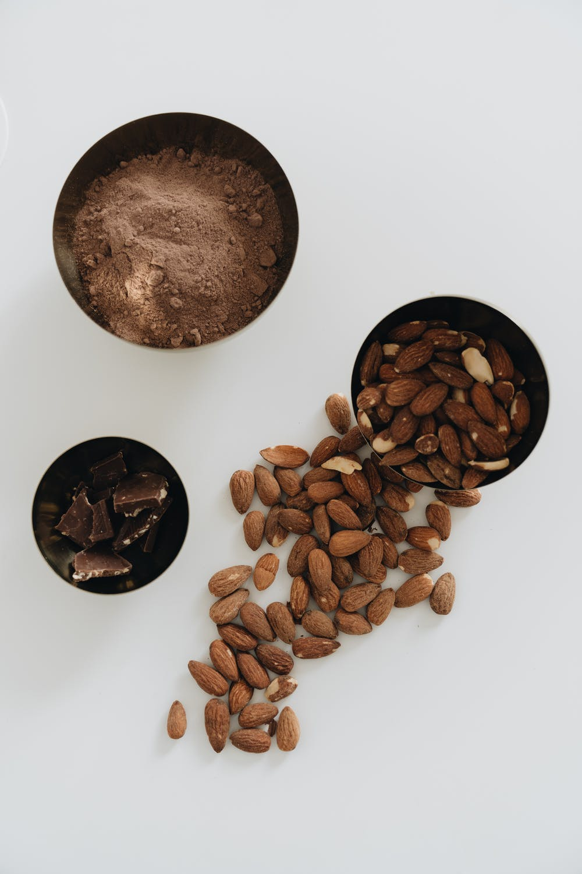


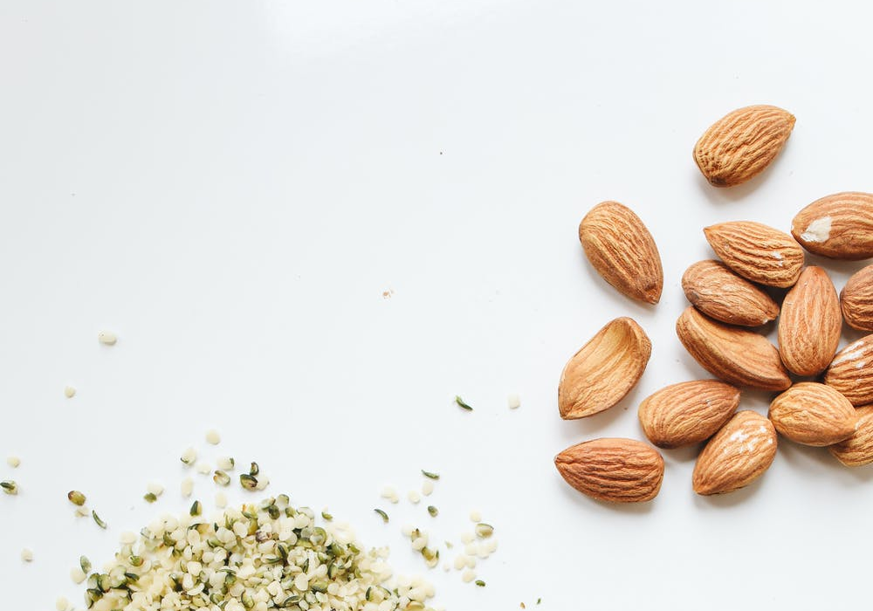
MOODBOARD

Slide 12
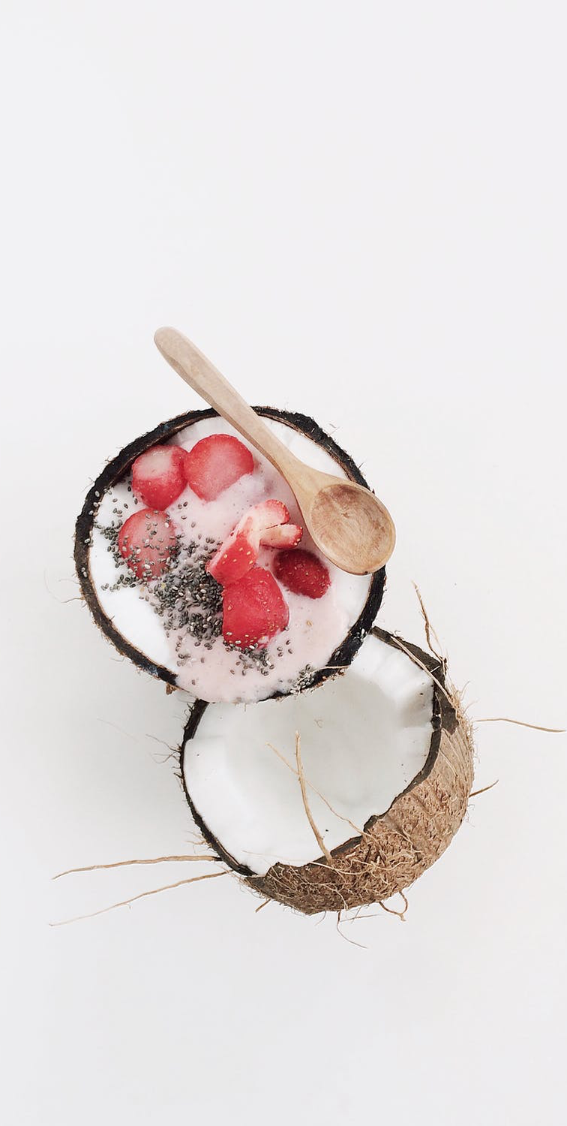
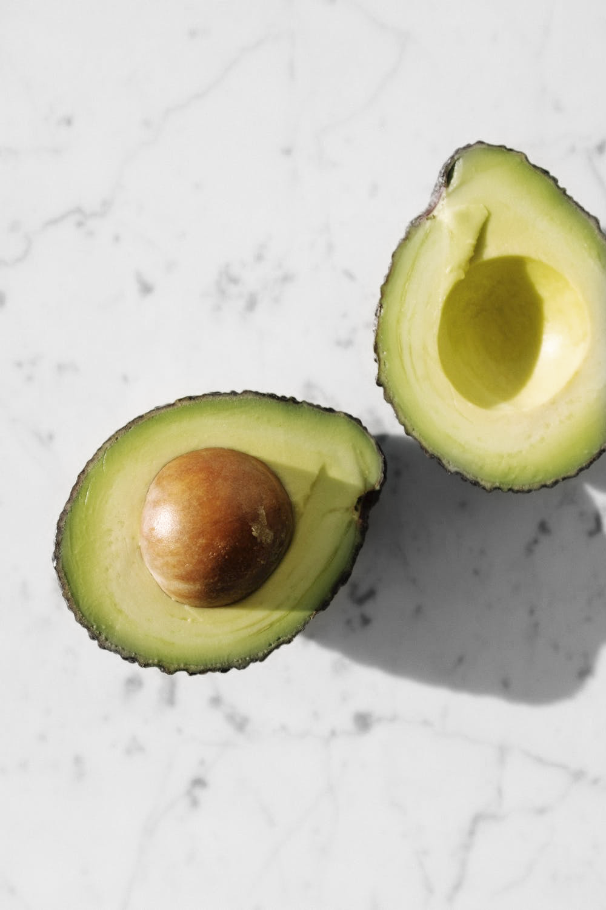
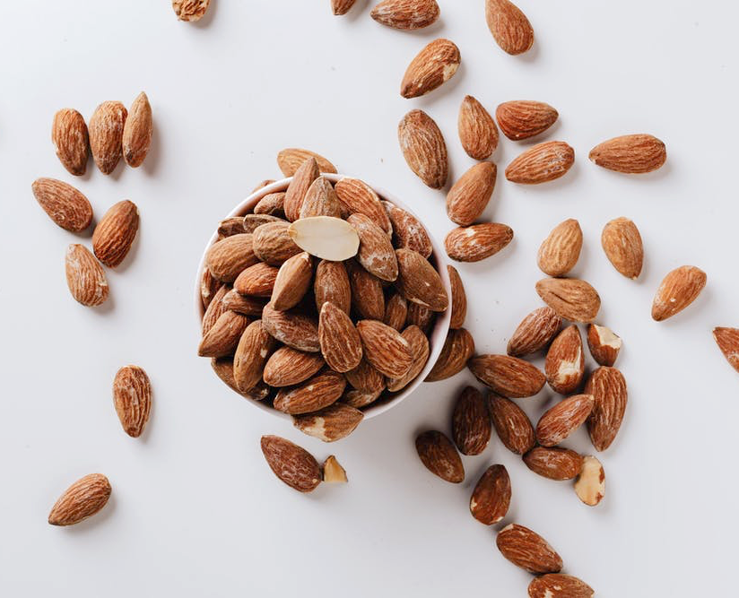
TV ADVERTS
A series of comical 60-second TV spots exploring the question: "If a coconut/almond/avocado could scream, what would it sound like?"

Slide 13
SOCIAL
Insta-famous plant-based food influencers film their vegan-denialist friends as they devour ice cream made with pea-milk that they think is from a regular cow.

Slide 14

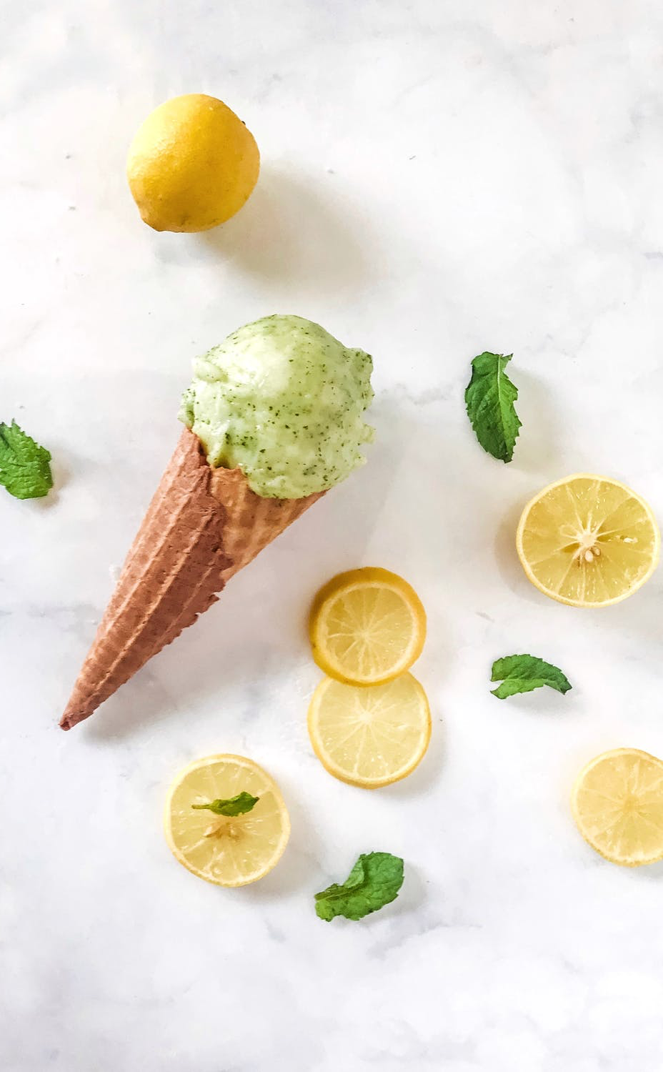

PR
Celebrity vegans: Marinara Grande, Lisso, and Zack Ephron are filmed giving out free samples at local stores.

Slide 15
WHY IT WORKS
PROOF POINT 1
The inside scoop: This is the major reason this creative strategy will work.
PROOF POINT 2
An even more valid point here.
PROOF POINT 3
And if they need more convincing, here's a third scoop of cold, hard evidence.
IMAGE CAPTION

Slide 16
MARKETING PLAN
SOCIAL MEDIA
MARKETING STUNT
TV
PRINT
MARCH
APRIL
MAY
JUNE

Slide 17
MARKETING PLAN
MARCH
APRIL
MAY
JUNE
Social media
TV
Print
Marketing stunt

Slide 18

MARKETING BUDGET
CREATIVE BUDGET
MEDIA BUDGET
Marketing channel
Social media
TV
Marketing stunt
$ 2000
$ 4000
$ 4500
$ 25000
$ 5000
$ 6700
$ 3500
$ 29000
TOTAL
$ 25000
$ 25000

Slide 19
NEXT STEPS
JAN
FEB
APRIL
MARCH
MAY
JUNE
Visit the agency and meet the team
Strategy, creative, and pre-production
Launch campaign at height of summer
Social and PR initiatives

Slide 20
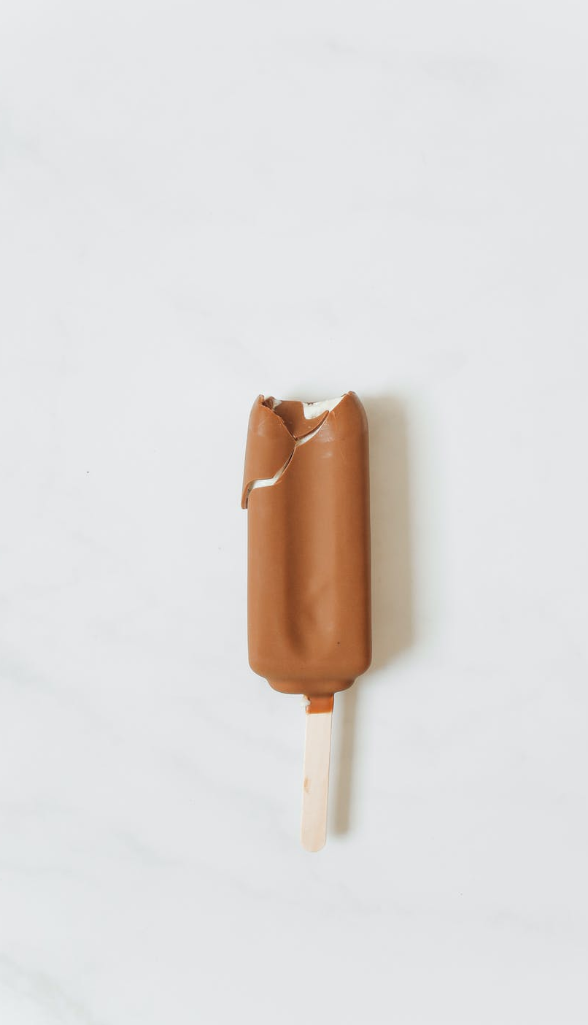
LET'S WORK TOGETHER
That's it! We've presented our pitch, and now we'll tell you why we're so excited to work with Coco-Ice.
ANY QUESTIONS? NOW IS THE TIME TO ASK.

Slide 21



MEET THE TEAM
CREATIVE DIRECTOR
ACCOUNT MANAGER
DESIGN LEAD
Talk about how good your creative director is at managing creatives, staying true to a campaign's vision, and delivering excellence.
Here's the person talking to the client the most — so really talk them up here. They are your not-so-secret ingredient.
The zingy wordy grammar fiend, who's going to make this ice cream snap, crackle, and pop-sicle.

Slide 22

CONTACT
WEBSITE
PHONE
EMAIL
www.omnilom.com
+032 376-006
info@omnilom.com

