Slide 1
Grad
Photo album
uation
Class of 20XX

Slide 2
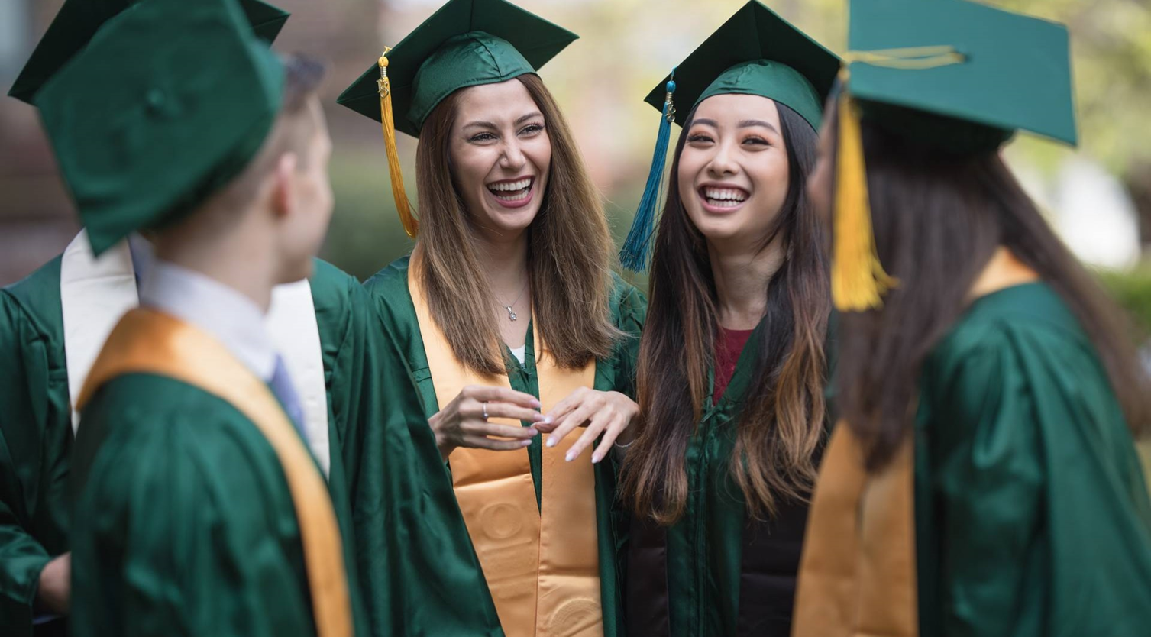
GRAD-UATING CLASS
OF
20XX
Celebrating with the best of friends

Slide 3
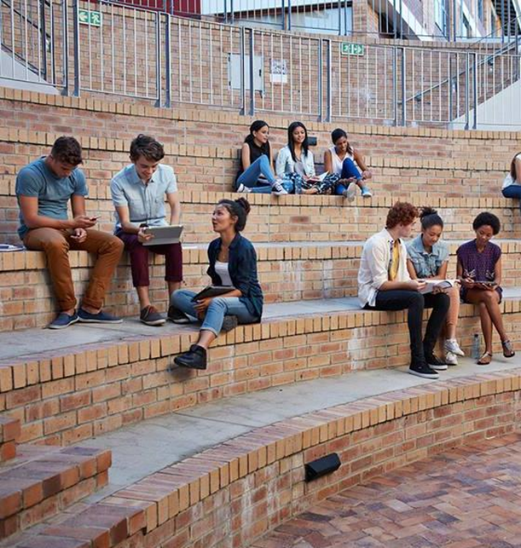
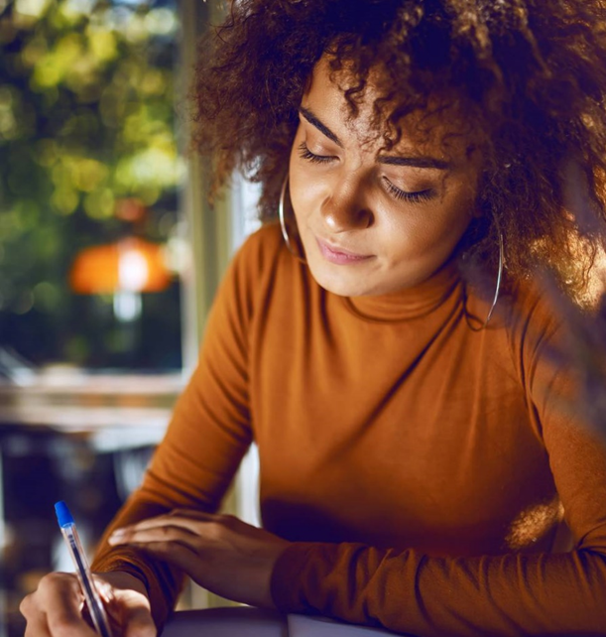
Flash
Back
To fresh-man year
Studying with friends
Creative writing course

Slide 4
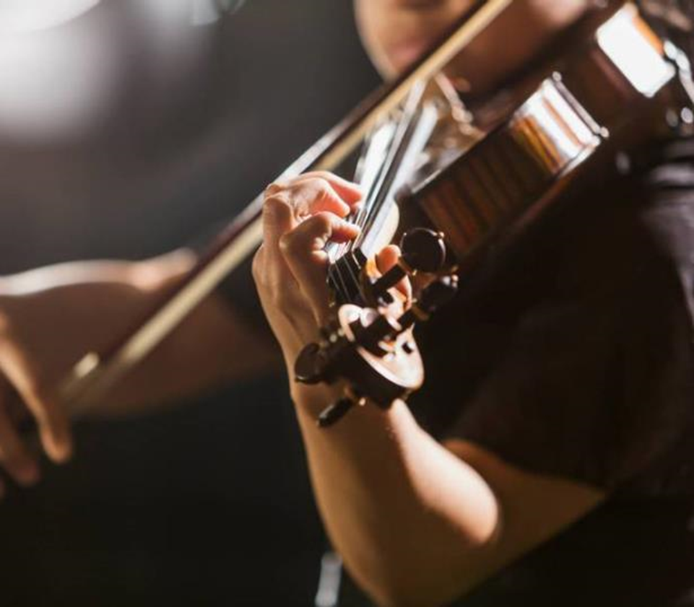
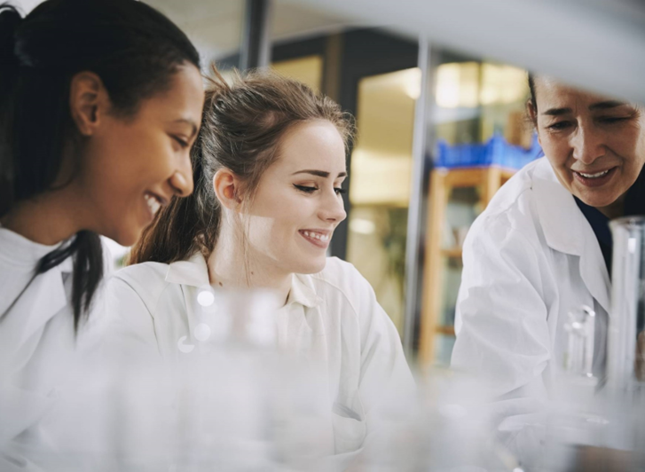
Club sports
& Activities
Chemistry lab with Ms. Morgan
Spring orchestra recital

Slide 5
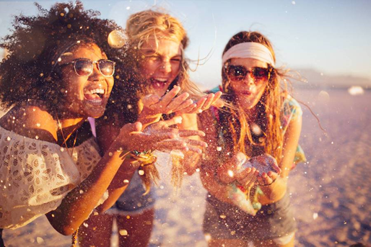
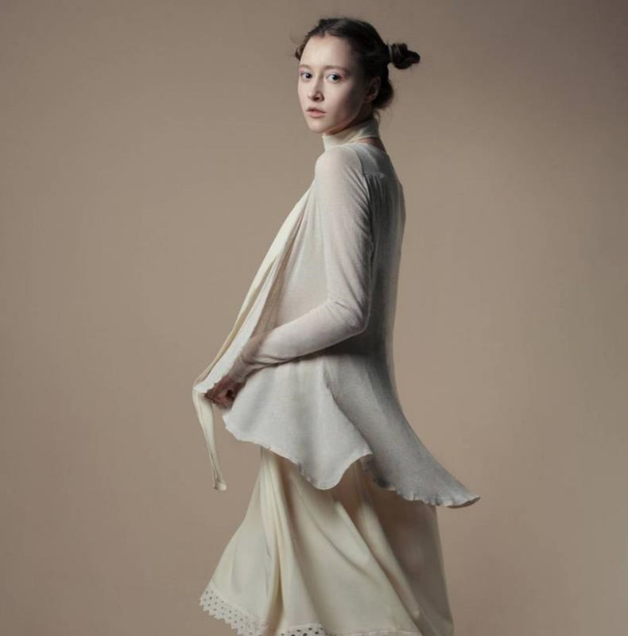

EVENTS & DANCES
Top left: Day at the beach
Bottom left: Disco dance night
Right: Senior fashion show

Slide 6
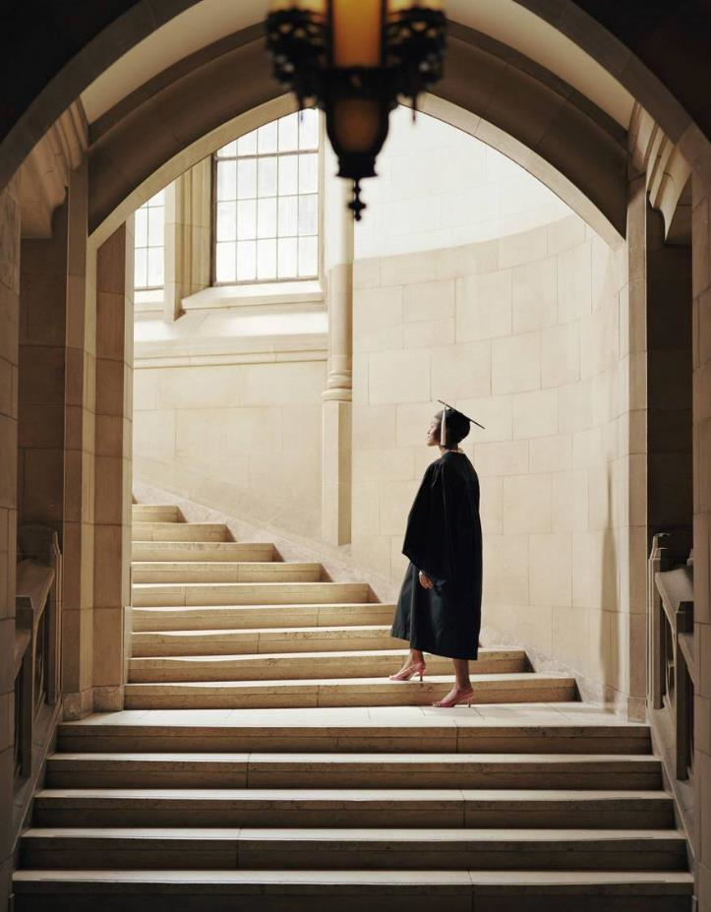
Senior quote
EVERY GREAT DREAM BEGINS WITH A DREAMER.​
- Harriet Tubman

Slide 7
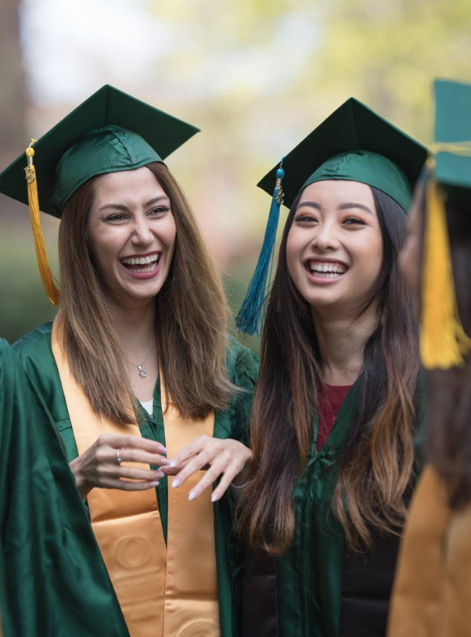
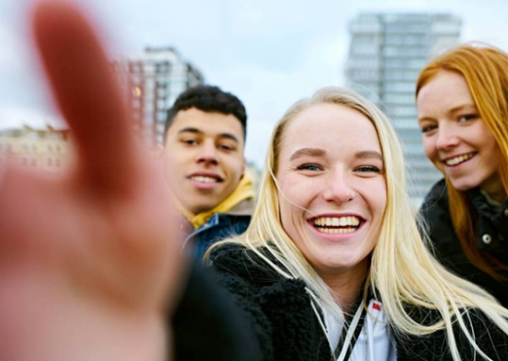
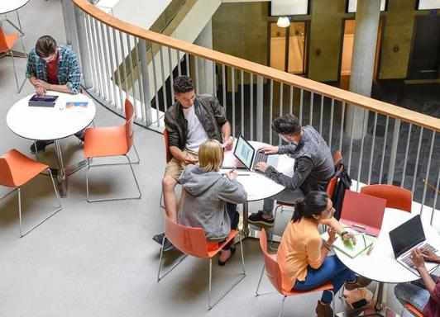
EVENTS & DANCES
Left: Graduation day
Top right: BFF road trip
Bottom right: Student center

Slide 8
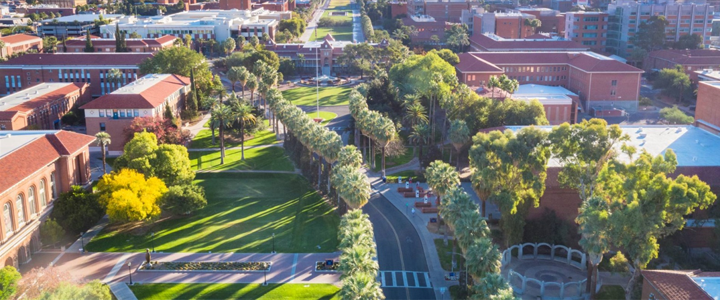
COLLEGE BOUND
NEXT YEAR I WILL BE ATTENDING:
WHAT I’M LOOKING FORWARD TO THE MOST:
Glenwood University
LIVING IN THE DORMS
I PLAN TO MAJOR IN:
WHAT I’LL MOST MISS ABOUT HIGH SCHOOL:
ECONOMICS
MY FRIENDS

