Slide 1
Coronavirus Health and Safety Tips
Wash your hands often
Use hand sanitizer
Wear a mask
Don’t touch your face
Cover your sneezes and coughs
Avoid close contact
Use your own supplies
Clean your electronics

Slide 2
Remember to wash your hands

Slide 3
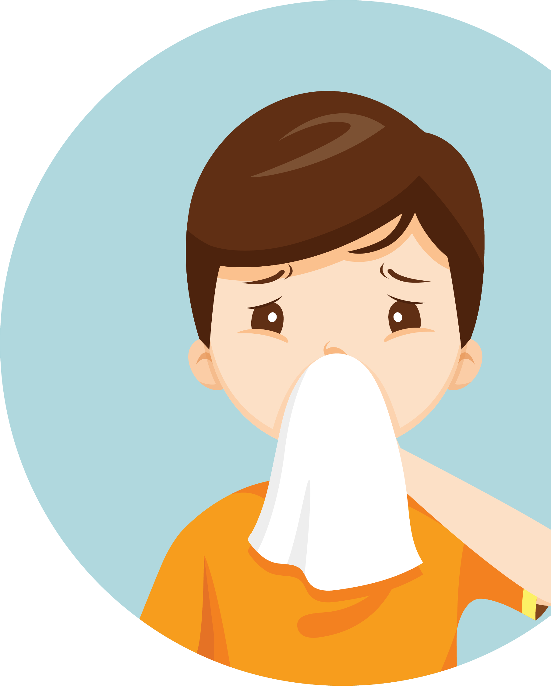
Please cover your cough and sneezes

Slide 4
Please wear a mask

Slide 5
Please wait here

Slide 6
Please practice social distancing

Slide 7
Wipe down between use

Slide 8
Avoid
shaking
hands,
high fives,
and hugs

